Slide 1
The New U.S. –Canada- Mexico Trade Agreement
Implications for Energy
Mexico City
January 29, 2019
Lucian Pugliaresi
Energy Policy Research Foundation, Inc.
Washington, DC
eprinc.org

Slide 2
Main Oil & Gas Provisions of USMCA
Agreement Does Not Shift Energy Flows Substantially – but Sound Policies Still Matter
Investment protections to which all countries commit
Eligibility for Investor-State Dispute Settlement for US oil and gas companies investing in Mexico
Continued market access and no tariffs for US natural gas and oil products
A requirement that Mexico retain at least its current level of openness to US energy investment
Additional flexibility allowing US customs authorities to accept alternative documentation to certify that oil and gas entering the US have originated in Canada or Mexico

Slide 3
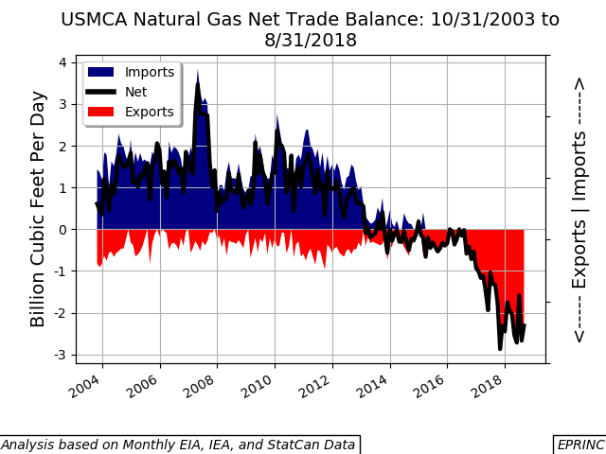
3

Slide 4
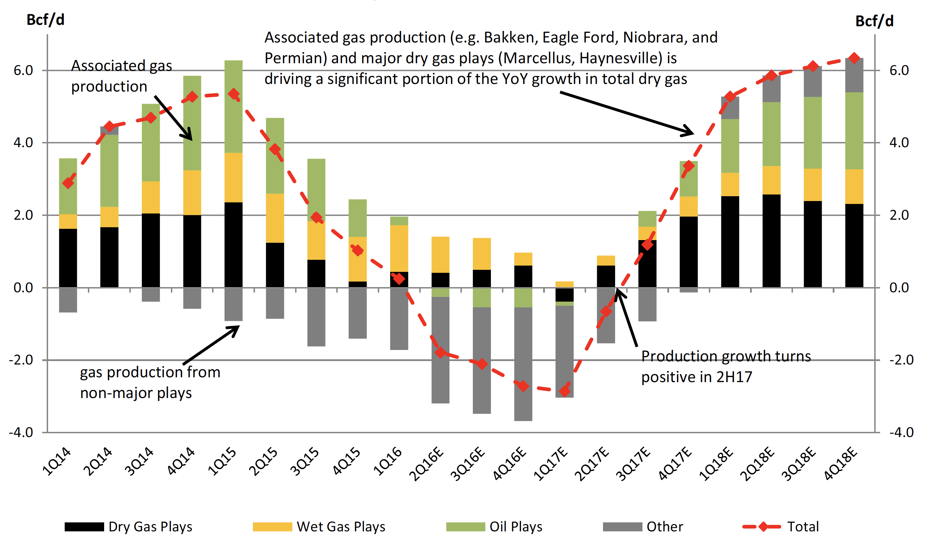
US Associated Gas Needs a Home – or Oil Output Suffers
Source: EIA, Raymond James

Slide 5
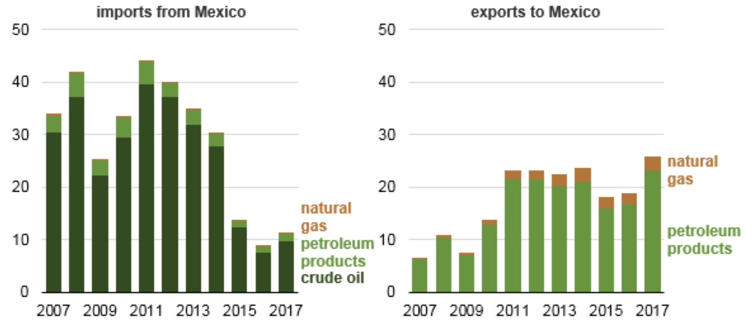
VALUE OF US PETROLEUM TRADE WITH MEXICO
billions of USD -- 2007-2017
Source: EIA

Slide 6
SUSTAINING THE BENEFITS OF USMCA
FIRST ORDER OF BUSINESS: TAMING POPULIST SENTIMENT
IMPORTANCE OF EDUCATING POLITICAL LEADERSHIP ON BENEFITS ON INTERCONNECTED ENERGY FLOWS
ADDRESS MEXICO’s ENERGY SECURITY CONCERNS (real and imagined)
ADDRESS INFRASTUCTURE BOTTLENECKS: ALL MEMBERS OF USMCA HAVE A STAKE IN Canadian, US, and Mexican Regulatory Risks
ACCESS TO MEXICAN GAS MARKET IMPORTANT FOR SUSTAINING US
CRUDE OIL OUTPUT GROWTH

