Slide 1
Implications of Changing Energy Policies in the Oil and Gas Sector
Understanding the Value of the North American Production Platform
Mexico City
January 29, 2019
Lucian Pugliaresi
Energy Policy Research Foundation, Inc.
Washington, DC
eprinc.org

Slide 2
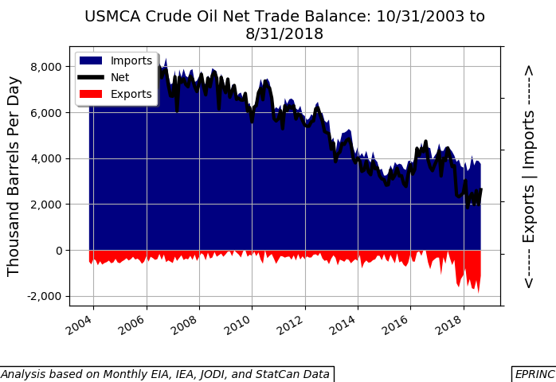
2

Slide 3
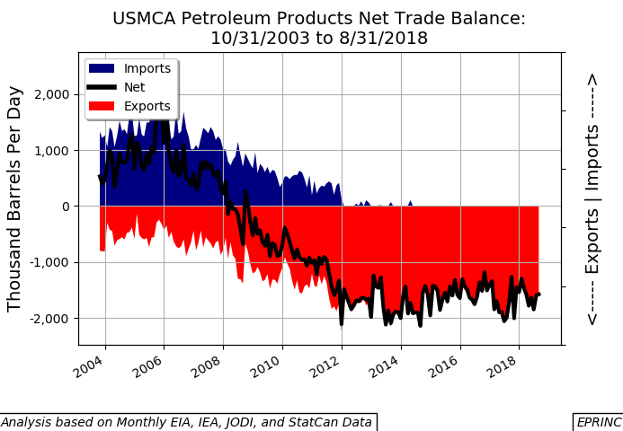
3

Slide 4
Royalties from Planned Oil Projects
(millions of dollars)
Source: EPRINC Report, Understanding the Economic Value of Mexico’s Energy Reform Program, by M. Lynch (December 2019)

Slide 5
